Slide 1
For Live Session Unit 7
Javier Saldana

Slide 2
Which model do you think is appropriate to use to forecast your time series? Why? Add this to the Google Doc as well as to your PowerPoint deck.
I believe the deterministic signal-plus-noise model is ideal for my time series. With the stock price of the Dow Jones Industrial, it is clear the price has a hidden signal formula which is coated by the noise in the model. The price of the DJI continues to increase, which would support a signal-plus-noise model.

Slide 3
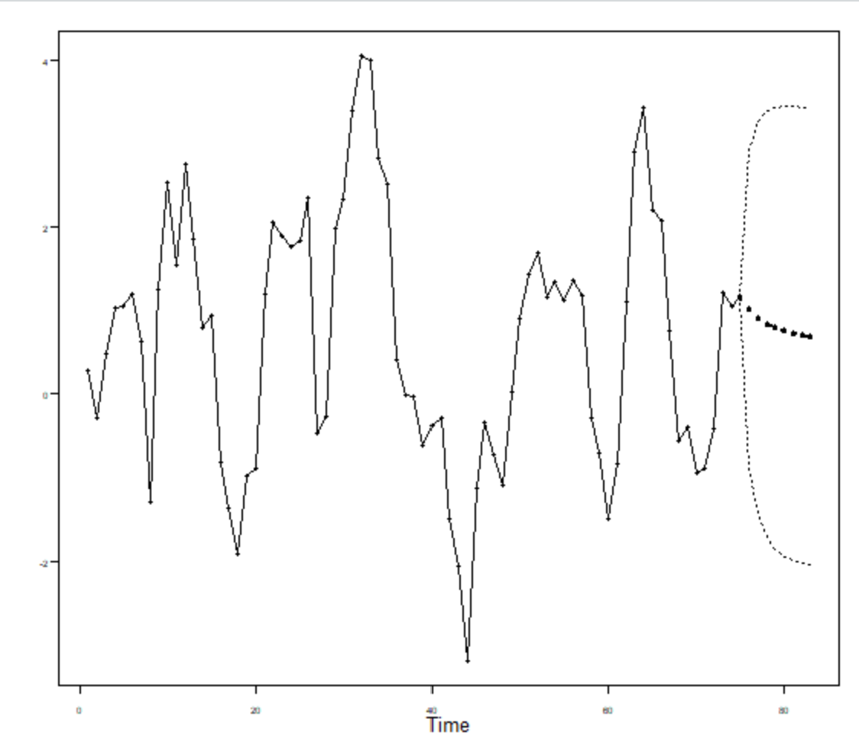
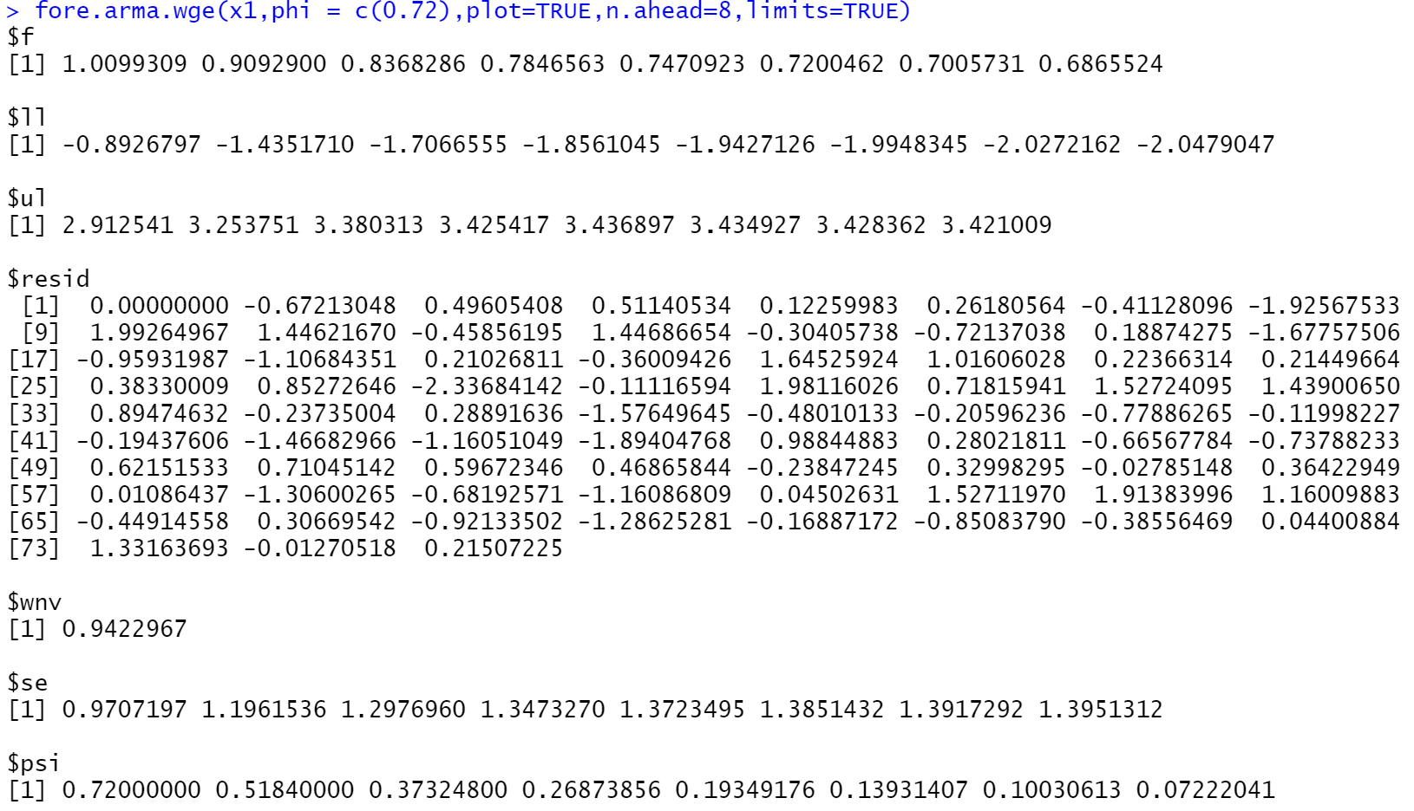
Find the first 5 psi weights for the model below, and use them to find the half-width of the 95 percentile probability interval for the third forecast (Xhat(3)). Please show your work as well as a plot of the series and the first eight forecasts with probability intervals.
(1–.9B)(1–.8B)Xt = at X1 = 5 X2 = 8 X3 = 9 X4 = 8 X5 = 7 X6 = 6 X7 = 4 X8 = 3

Slide 4
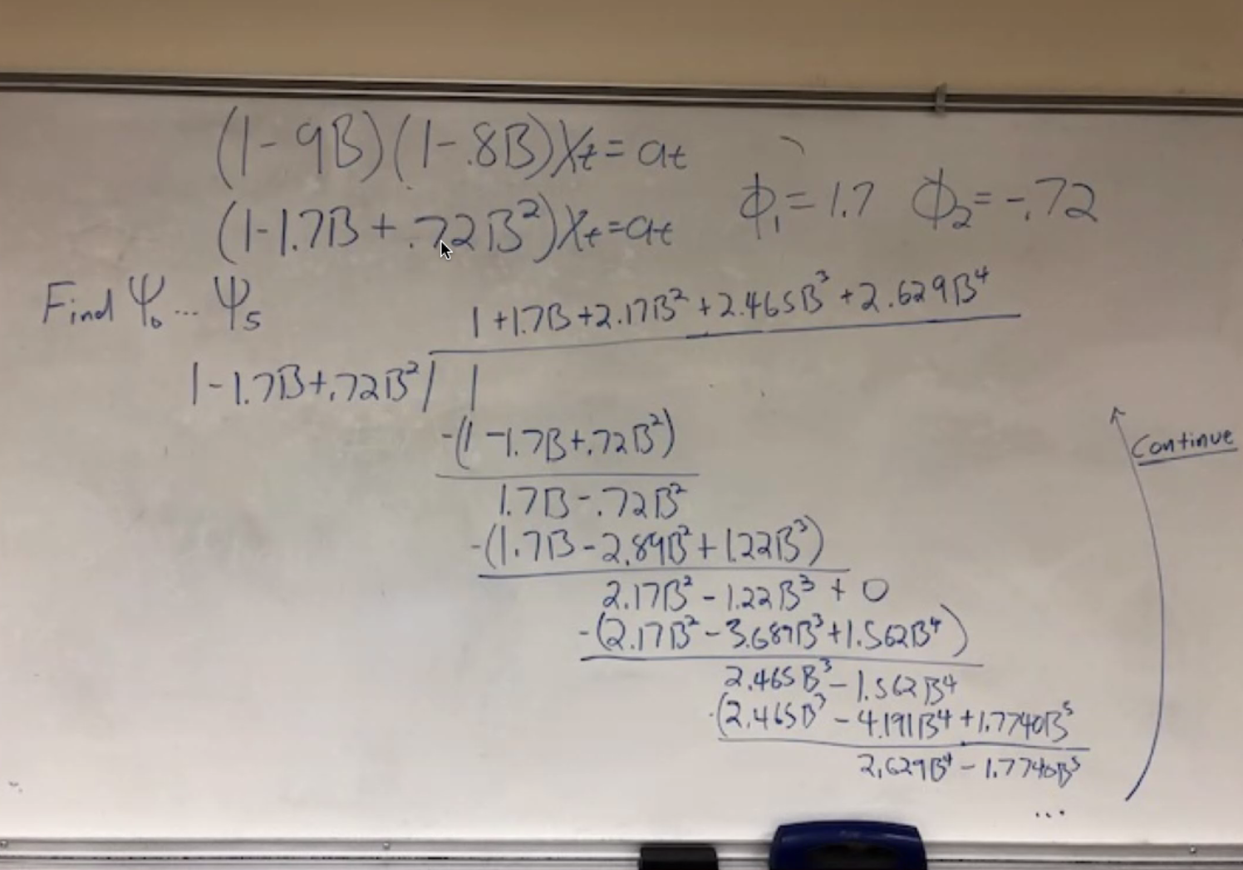
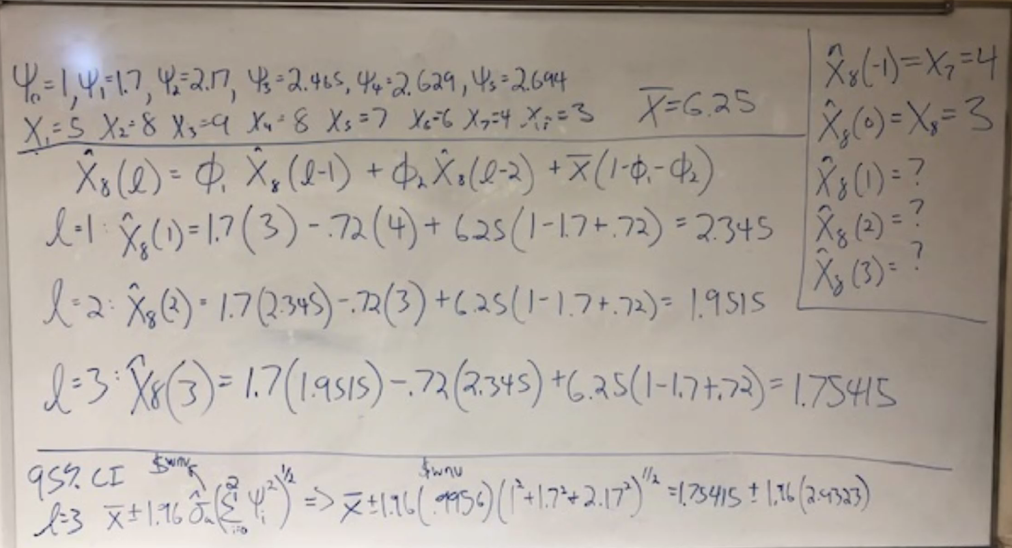
Find the first 5 psi weights for the model below, and use them to find the half-width of the 95 percentile probability interval for the third forecast (Xhat(3)). Please show your work as well as a plot of the series and the first eight forecasts with probability intervals.
(1–.9B)(1–.8B)Xt = at X1 = 5 X2 = 8 X3 = 9 X4 = 8 X5 = 7 X6 = 6 X7 = 4 X8 = 3

Slide 5
Thoughts and Key Takeaways
Forecasting is by far my favorite lesson. I understood the material and felt comfortable working through the problems. However, I had a quick question. In 7.6, I am not sure who we can calculate the standard deviation hat without the data. Throughout the unit, I felt like it was provided and then we had to solve for it.

